Slide 1
Direct Address Tables
Pro Academy I
Data Structure
Notes:
By leonardi.l

Slide 2
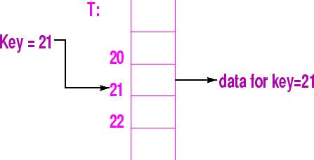
DAT?
If the number of possible keys is small and they are unique, then the table can be a BIG array.
Let the universe of m possible keys be
U = {0, 1, .., m-1}.
Direct-Address Table T[0,..,m-1] is an array. Each slot (array element) corresponds to a unique key.

Slide 3
DAT algorithm
Insert(T,x)
T[key(x)] = x
Search(T,x)
return(T[key(x)])
Delete(T,x)
T[key(x)] = NIL

Slide 4
Speed
Algorithm | Average | Worst Case
Space | O(n) | O(n)
Search | O(1) | O(1)
Insert | O(1) | O(1)
Delete | O(1) | O(1)

Slide 5
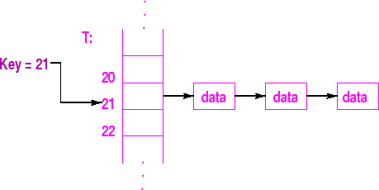
Assumptions
Heavily assume that the key is small and unique
What if the keys are not unique?
Solution 1 : Insert = Replace
Solution 2 : Array elements = pointer to lists
Hash tables?

